Slide 1
北京·清华大学
2022年9月5日-9日

Slide 2
Sound Adversarial Audio-Visual Navigation
Yinfeng Yu, Wenbing Huang, Fuchun Sun, Changan Chen, Yikai Wang, Xiaohong Liu
This work aims to do an adversarial sound intervention for robust audio-visual navigation.
Notes:
智能体通过第一视角的视听观察在未知的三维环境中找到声源是视听导航。我们旨在解决声音嘈杂环境下的视听导航问题。声音嘈杂的环境怎么构建？我们通过最坏情况的思想，构建了一个声音攻击者，它可以移动和改变声音的音量和类别，使智能体在寻找目标声源的过程中受到干扰。通过设计，完成了声音嘈杂环境下的视听导航。实验使用两个真实世界的3d扫描数据集Replica 和 Matterport3D，验证了我们设计的两个智能体的算法在声音嘈杂环境下的有效性和稳健性。

Slide 3
Motivation
SoundSpaces^{[1]} is focus on audio-visual navigation problem in the acoustically clean or simple environment.
However, there are many situations different from the setting of SoundSpaces, which there are some non-target moving sounding objects in the scene:
For example, a kettle in the kitchen beeps to tell the robot that the water is boiling, and the robot in the living room needs to navigate to the kitchen and turnoff the stove; while in the living room, two children are playing a game, chuckling loudly from time to time.
The limitation of existing navigation agent/training
environments: they cannot model non-target moving
sounding objects.
[1] C. Chen*, U. Jain*, et al., SoundSpaces: Audio-Visual Navigation in 3D Environments, ECCV 2020

Slide 4
Challenges
Challenge 1:
How to model non-target moving sounding objects in a simulator or reality? There is no such setting that existed!
Challenge 2:
Can an agent still find its way to the destination in an acoustically complex environment?

Slide 5
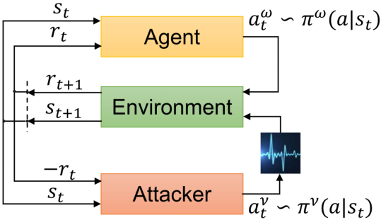
Our ideas
How to model?
Worst case strategy: Regard non-target sounding objects as deliberately embarrassing the robot. We called them sound attackers.
Simplify: Only consider the simplest situation, one sound attacker.
Zero-sum game: One agent, one sound attacker.

Slide 6
Contributions
We construct a sound attacker for audio-visual navigation that aims to improve the agent’s robustness.
We develop a joint training paradigm for the agent and the attacker.

Slide 7
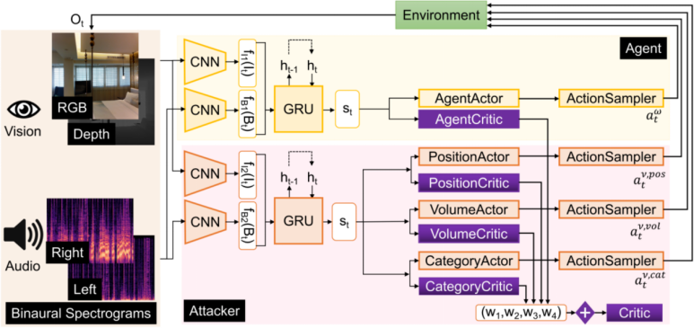
Neural network model
The agent and the sound attacker first encode observations and learn state representation $s_{t}$ respectively. Then, $s_{t}$ are fed to actor-critic networks, which predict the next action $a_{t}^{ω}$ and $a_{t}^{ν}$ .

Slide 8
Experiment Setup
Baselines:
Random: A random policy that uniformly samples one of three actions.
AVN^{[1]}: An audiovisual embodied navigation trained in an environment without sound intervention.
SA-MDP^{[2]}: We adopt its idea but only intervene state of the sound input and do not process the visual information.
Metrics :
SPL: Success weighted by Path Length
R_{mean}: stands for average episode reward of agent
SSPL: Soft Success weighted by Path Length
SR: Success Rate
DTG: average Distance To Goal
NDTG: Normalized average Distance To Goal
[1] C. Chen*, U. Jain*, et al., SoundSpaces: Audio-Visual Navigation in 3D Environments, ECCV 2020
[2] H. Zhang, H. Chen, et al., Robust deep reinforcement learning against adversarial perturbations on state observations, NeurIPS 2020

Slide 9
Demos
This is a demo on Replica in the clean environment.
4x Speed

Slide 10
Demos
This is a demo on Matterport3D in the complex environment.
4x Speed

Slide 11
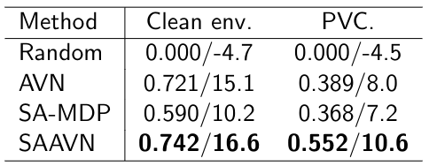
Experiment Results
Our model is better than others in both clean and complex environments from the following tables.
Performance comparison of different models on Replica.
an acoustically
complex environment
Performance comparison of different models on Matterport3D.
Comparison of different models under SPL (↑)/R_{mean} (↑) metrics.

Slide 12
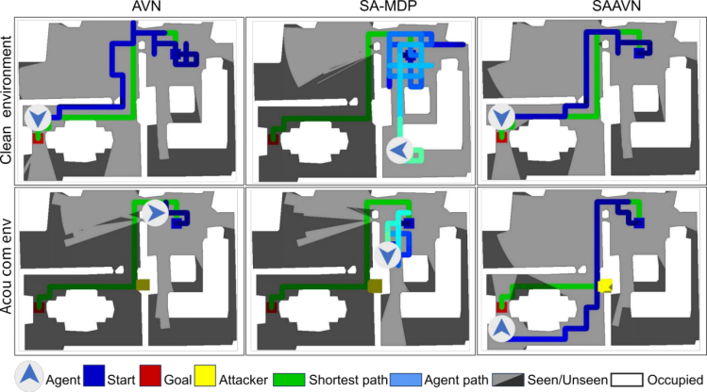
Navigation Trajectories
AVN: can complete the task in a clean environment but fails in an acoustically complex environment.
SA-MDP: was unable to complete the job successfully in all two settings.
SAAVN (ours): reaches the goal most efficiently.

Slide 13
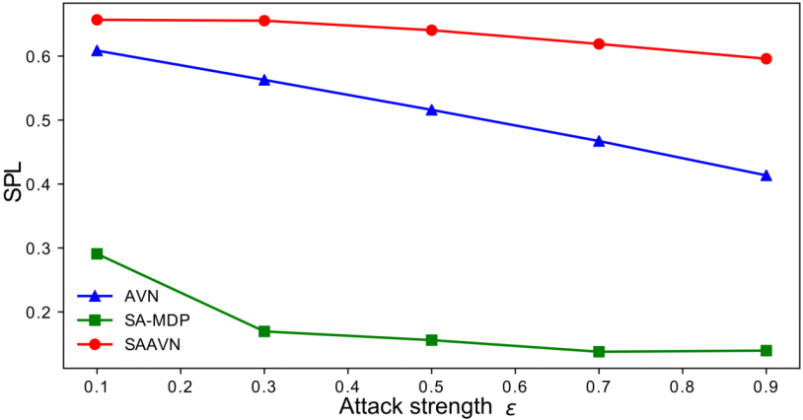
Robustness
Our method’s performance decreases more slowly under different attack strength, which fully demonstrates that our approach helps improve the robust performance of the algorithm.

Slide 14
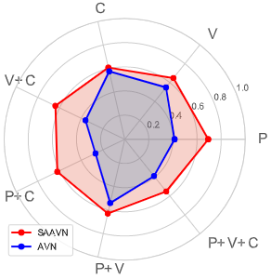
Ablation study
Ablation study for the attack policy regarding the position, volume, and sound category.
Our model’s performance is better than AVN in all environments.

Slide 15
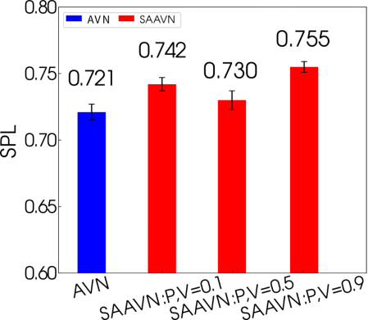
Ablation study
The relationship between SPL and the volume of the sound attacker is not straightforward.
It depends on other factors, including the position and sound category.

Slide 16
Conclusion
We proposed a game with a sound attacker.
We designed various policies for the sound attack.
We rationally model the gap between research and application.
For more details, please refer to the original paper.

Slide 17
Sound Adversarial Audio-Visual Navigation
Yinfeng Yu, Wenbing Huang, Fuchun Sun, Changan Chen, Yikai Wang, Xiaohong Liu
ICLR 2022
The project and code can be viewed at the following website:
https://yyf17.github.io/SAAVN

