Slide 1
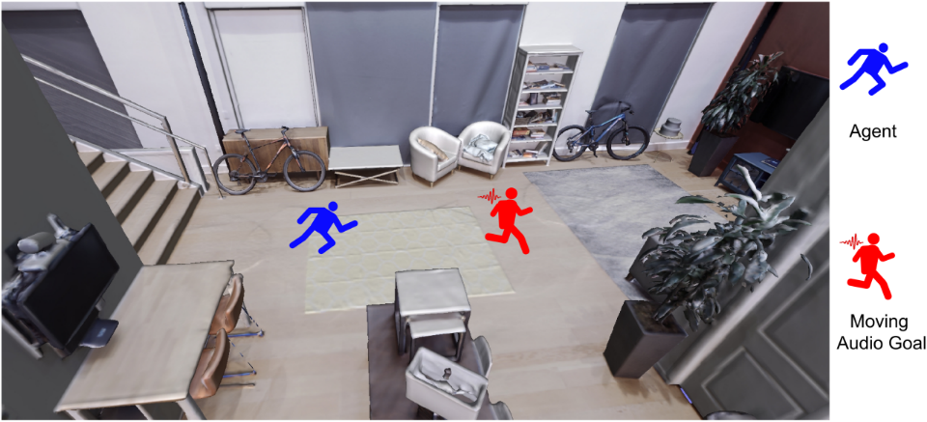
Pay Self-Attention to Audio-Visual Navigation
Yinfeng Yu, Lele Cao, Fuchun Sun, Xiaohong Liu, Liejun Wang
Tsinghua University (THU)
Audio-visual embodied navigation with a moving sound source as the target: a blue robot chases a moving target (red), a low-speed robot emitting sound.

Slide 2
Motivation
The relative contribution of each modal in real-time is dynamically different[1] at a separate time step.
So how to learn the fusion dynamically?
We summarize the current fusion method for audio-visual fusion in audio-visual navigation and propose our solution in the following figure.
High-level illustration of different feature fusion methods in audio-visual navigation.
[1] C. Chen*, U. Jain*, et al., SoundSpaces: Audio-Visual Navigation in 3D Environments, ECCV 2020

Slide 3
Contributions
We propose an end-to-end framework (FSAAVN) to address a currently under-researched problem: audio-visual navigation to chase a moving sound target.
We design a novel audio-visual fusion module (FSA) for learning a context-aware strategy to determine the relative contribution of each modal in real time.
We experimentally benchmark our approach towards the state-of-the-art in 3D environments, showing the superior performance of FSAAVN.
The thorough comparison of different variants of the fusion module (above Figure) and visual/audio encoder [The considered encoders: CNN (convolution neural network), ViT (vision transformer), Capsule. ] provides valuable insights for future practitioners in this field.

Slide 4
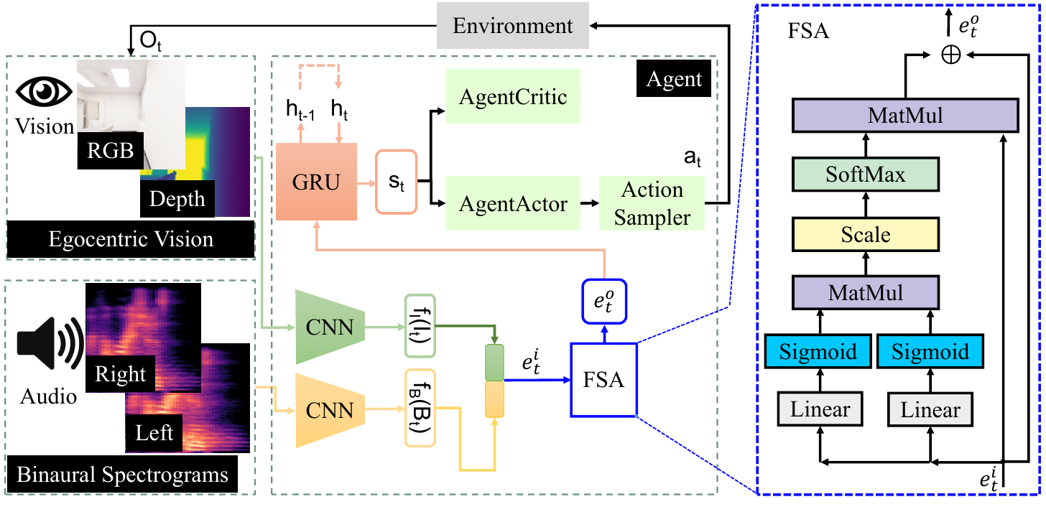
Neural network model
The overview of FSAAVN: Feature Self-Attention Audio-Visual embodied Navigation.

Slide 5
Experiment Setup
Baselines:
SoundSpaces^{[1]}: An audiovisual navigation model for static AudioGoal, using concat fusion method for audio and visual features
SoundSpaces-EMul: like SoundSpaces, element-wise multiplication for audio and visual features
SoundSpaces-EM: like SoundSpaces, lement-wise mean for audio and visual features
CMHM^{[2]}: the first and only published work to tackle the moving-sound problem within unexplored environments.
AV-WaN^{[3]}: predicts waypoints (represented as a topological graph) to improve long-distance navigation performances.
Metrics :
SPLT: Success weighted by Path Length for Tracking
SSPLT: Soft Success weighted by Path Length for Tracking
SRT: Success Rate for Tracking
[1] C. Chen*, U. Jain*, et al., SoundSpaces: Audio-Visual Navigation in 3D Environments, ECCV 2020
[2] A. Younes, D. Honerkamp, et al. Catch me if you hear me: Audio-visual navigation in complex unmapped environments with moving sounds. abs/2111.14843, 2021.
[3] C. Chen, S. Majumder, et al. Learning to set waypoints for audio-visual navigation. ICLR 2021.

Slide 6
Experiment Setup
Two datasets
(1) Replica: 18
(2) Matterport3D: 85
Three different sound source splittings
(1) Telephone: the target sound source (telephone) is the same in the training, validation and testing sets;
(2) Multiple heard: all 102 sounds exist in three sets;
(3) Multiple unheard: the 102 sounds are divided into non-overlapping 73/11/18 splits for train/validation/test.
Four feature fusion methods in audio-visual navigation
(1) Concat (2) Element-wise Mul (3) Element-wise Mean (4) Feature self-attention

Slide 7
Demos
This is a demo on Replica of our model given RGBD input.

Slide 8
Demos
This is a demo on Matterport3D of our model given RGBD input.

Slide 9
Experiment Results
Table 1: Overall performance comparison (STDEV≤0.01) using depth and sound input.
Table 1: shows that FSAAVN using FSA fusion, constantly performs the best (in boldface) on both datasets
in all splitting settings.

Slide 10
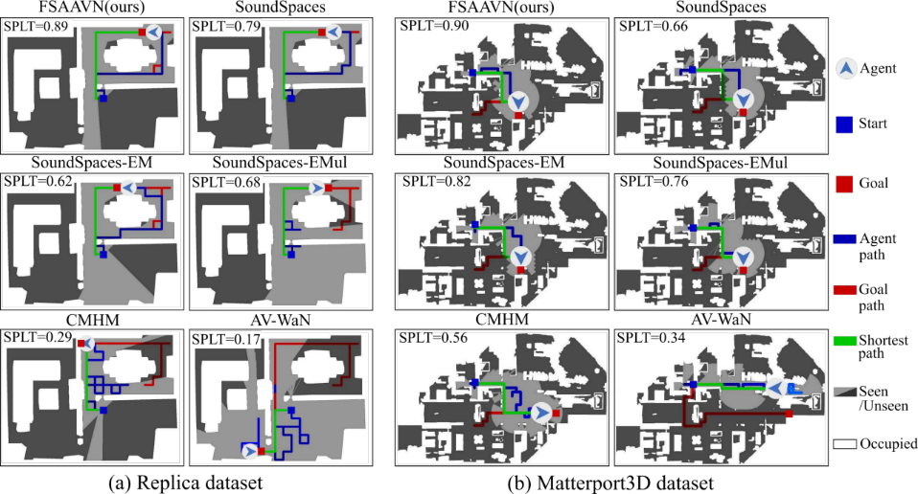
Experiment Results
Navigation trajectories by the end of a particular episode from (a) Replica and (b) Matterport3D dataset.
Higher SPLT values and shorter blue paths indicate better performances.

Slide 11
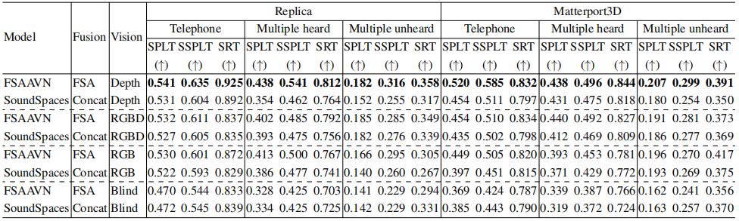
Experiment Results
Table 2: Performance Comparison (STDEV≤0.01) of different vision modalities.
From Table 2, we can conclude that:
1) among all tested modalities, depth alone achieves the best performance;
2) with the same modality, FSA performs better than simple concatenation;
3) in the case of the blind, FSA seems slightly worse than concatenation, probably caused by FSA’s higher flexibility and complexity than concatenation.

Slide 12
Experiment Results
Table 3: Performance Comparison (STDEV≤0.01) of different visual/audio encoder backbones.
Table 3 shows the results of using different encoders while keeping the other parts the same.
We can see that the overly complex encoders (Capsule and ViT-based ones) are inferior to the CNN encoder.
Higher complexity increases the convergence difficulty and thus makes policy learning more challenging.

Slide 13
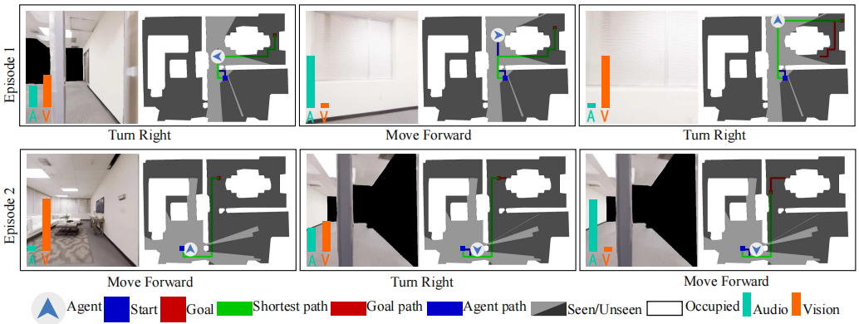
Experiment Results
Dynamic visual and echo impact for two episodes. Columns corresponds to three sampled time steps.
The green and orange bars represent the importance of audio and vision, respectively.
The left figure shows the impact scores (for two episodes in two rows) on the egocentric robot view
at different time steps.
We can see that FSAAVN dynamically re-weight the modalities (according to the current surroundings)
while chasing after the moving audio target.

Slide 14
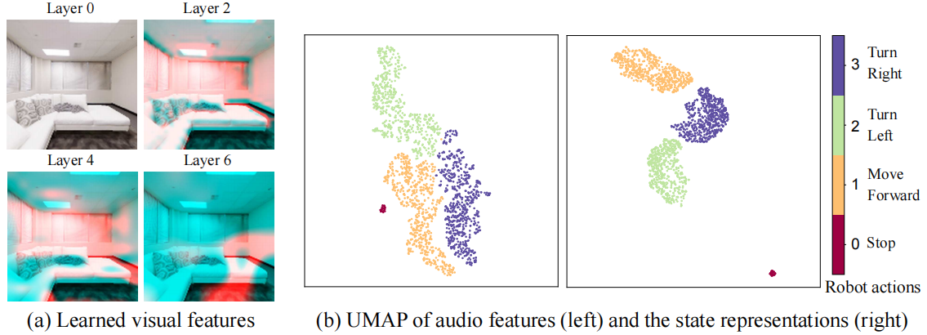
Experiment Results
Visualization of visual feature, audio feature, and state representations from Replica dataset.

Slide 15
Conclusion
To realize a more effective (than the existing methods) audio-visual feature fusion strategy during audio-visual embodied navigation, we designed a trainable Feature Self-Attention (FSA) module.FSA determines the relative contribution of visual/audio modal in real-time following the ever-changing context.
We propose an end-to-end framework (FSAAVN: feature self-attention audio-visual navigation) incorporating FSA to train robots to catch up with a moving audio target.
FSAAVN is easy to train since it requires no extra aid like topology graphs and sound semantics.
Our comprehensive experiments validate the superior performance of FSAAVN compared to the state-of-the-art.
We also conduct thorough ablation studies on mainstream visual modalities, signal (visual/audio) encoders and audio-visual fusion strategies, providing valuable insights for practitioners and researchers in this field.
For more details, please refer to the original paper.

Slide 16
Pay Self-Attention to Audio-Visual Navigation
Yinfeng Yu, Lele Cao, Fuchun Sun, Xiaohong Liu, Liejun Wang
The project can be viewed at the following website:
https://yyf17.github.io/FSAAVN

Slide 17
Thanks for your attention!

